Slide 1
How to work with connections, commands, and data readers (Connected Data Architecture)

Slide 2
Three-layer
Windows
applications
Notes:
Tree –layer Windows applications
You’ll learn how to develop three-layer applications that consist of presentation, business and database classes.
When you use this approach to you’ll write more code, but you’ll gain some benefits:
One of the benefits of this approach is that you are often able to reuse the code in your business and database classes for more than one application.
Another benefit is that your applications are usually easier to test, to debug, and maintain.
For these reasons, this development approach is commonly used for serious production applications.

Slide 3
Notes:
Tree –layer Windows applications
In this chapter, you’ll learn how to use connections, commands and data readers for building three-layer applications.
Then you’ll see these techniques used in a simple application.
When you’re done with this chapter, you’ll be able to develop simple three-layer applications of your own.

Slide 4
ADO.NET components for accessing a database

Slide 5
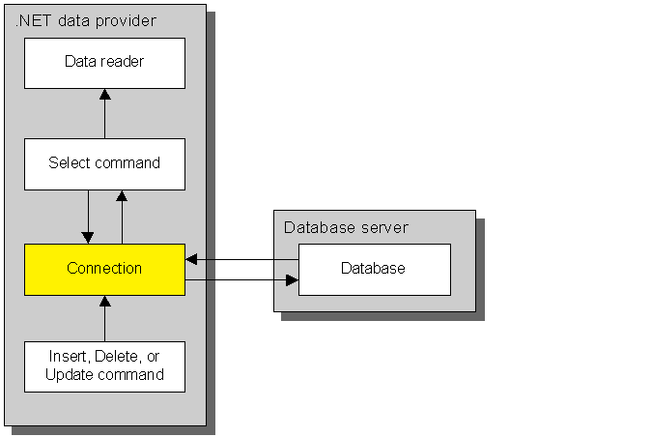
1. Connection
Notes:
Connection
Before you can execute a SQL statement, you must create a command object that will contain the SQL statement.
In addition, you must create a connection object that the command will use to connect to the database. You cannot execute a SQL statement without a connection.

Slide 6
Two constructors for the SqlConnection class
new SqlConnection()
new SqlConnection(connectionString)
Common properties and methods of the SqlConnection class
Property | Description
ConnectionString | Provides information for accessing a SQL Server database.
Method | Description
Open() | Opens the connection using the specified connection string.
Close() | Closes the connection
Dispose() | Releases all resources used by the connection
Notes:
Connection
The slide shows how you create and work with a connection for a SQL Server Database.
As you can see from the syntax at the top of the slide, you can specify a connection string when you create the connection.
If you do, this string is assigned to the ConnectionString property. Otherwise, you have to assign a value to this property after you create the connection object. This is illustrated by the first two examples on the slide.

Slide 7
Values for the ConnectionString property
Data Source/Server
Initial Catalog/Database
Integrated Security
User ID
Password/Pwd
Persist Security Info
Workstation ID

Slide 8
Code that creates, opens, and closes a SQL connection
string connectionString =
"Data Source=(localdb)\\mssqllocaldb; " +
"Initial Catalog=Payables;" +
"Integrated Security=True";
SqlConnection connection = new SqlConnection();
connection.ConnectionString = connectionString;
connection.Open();
...
connection.Close();
Another way to create a SqlConnection object
SqlConnection connection =
new SqlConnection(connectionString);
A connection string for the Jet OLE DB provider
Provider=Microsoft.Jet.OLEDB.4.0;
Data Source=C:\\Databases\\Payables.mdb
Notes:
Create, open an close a SQL connection
The first example shows how you can use the Open and Close methods to open and close the connection.
Note, through, that instead of using the Close method to close the connection, you can use the Dispose method. This method closes the connection and it releases all of the resources used by the connection., which means that you can no longer use the connection. Because of that, you’ll want to use Dispose only when you no longer need to use the connection.
The slide also shows some of the common values that you specify in a connection string. For a SQL Server Database, you typically specify the name of the server where the database resides, the name of the database, and the type of security to be used.
You can also specify the additional value shown in this slide. As well as others. For more information on these values, see the Visual Studio documentation.
To create a connection for an OLEDB provider, you use code similar to that shown on the slide. The main difference is the information that you provide for the connection string. The connection string for a Jet (Access) OLE DB provider, for example, is shown in the last example on the slide. Because the requirements for each provider differ, you may need to consult the documentation for that provider to determine what values to specify.
Notice in both the SQL Server and the Jet OLE DB connection strings that you must code two backslash characters (\\) for each backslash you want to include. Because the backslash identifies an escape sequence when coded within a string, you have to code the \\ escape sequence to include a single backslash character.
Before we go on, you should realize that the connection string for production applications are frequently stored in configuration files outside the application. That way, they can be accessed by any application that needs them, and they can be modified without having to modfiy each application that uses them.

Slide 9
A constructor for the SqlConnectionStringBuilder class
new SqlConnectionStringBuilder()
Common properties for working with a SqlConnectionStringBuilder
ConnectionString
DataSource
InitialCatalog
IntegratedSecurity
UserID
Password
PersistSecurityInfo
WorkstationID
Notes:
SqlConnectionStringBuilder
This slide presents another technique you can use to create a connection string. This technique uses the SqlConnectionStringBuilder class. If you review the properties of this class on the slide, you’ll see that, except for the ConnectionString property, they correspond with the values that you can include in a connection string.

Slide 10
Code that creates a connection string using a connection string builder
SqlConnectionStringBuilder builder =
new SqlConnectionStringBuilder();
builder.DataSource = “(localdb)\\mssqllocaldb";
builder.InitialCatalog = "Payables";
builder.IntegratedSecurity = true;
Code that uses the connection string to create a connection
SqlConnection connection =
new SqlConnection(builder.ConnectionString);
using (SqlConnection connection =
new SqlConnection(connectionString))
{
connection.Open();
...
}
Code that creates a connection in a using block
Notes:
SqlConnectionStringBuilder
The first example on the slide illustrates how you can use the SqlConnectionStringBuilder class to build the same connection string you saw earlier.
The first statement in this example creates the connectionStringBuilder. Then, the next three statements set properties that identify the server, the database, and the security to be used to connect to the server.
The second example shows you how you use a connectionStringBuilder with a connection. To do that, you use the ConnectionString property of the connectionStringBuilder to get the connectionString it contains. Then, you use that value to assign a connectionString to the connection.
Although this may seem like a roundabout way to create a connectionString it has some distinct advantages.
First, you don’t have to remember all the different values that you code for a connection string. Instead, you can use IntelliSense to locate the properties you need.
In addition, this technique makes it easy to construct connection strings at runtime. If you need to include a user ID and password that the user enters into a form, for example, you can do that easily by assigning the appropriate control properties to the UserID and Password properties of the connection string builder.
The last example shows how to use a using Block to create and dispose of a connection.
As you can see, you create the connection as part of the using statement, and you open the connection within the using block. Then, when the using block ends, the Dispose method of the connection is called automatically. This ensures that the resources for the connection are released as soon as it’s no longer needed. This is particularly useful for connections that are only needed for a short period of time.

Slide 11
Code that reads the connection string from the app.config file
app.config
<configuration> … <connectionStrings>
<add name="PayablesConnectionString" connectionString="Data Source=(localdb)\mssqllocaldb;Initial Catalog=Payables;Integrated Security=True“ providerName="System.Data.SqlClient" />
</connectionStrings>
…
</configuration>
payablesData project → Add Reference: System.Configuration
ConnectionFactory.cs
string connectionString = System.Configuration. ConfigurationManager.ConnectionStrings["PayablesConnectionString"].ConnectionString;
…

Slide 12
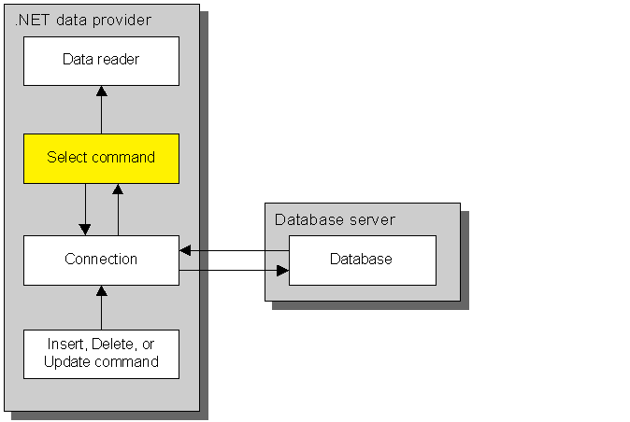
2. Command (SELECT)

Slide 13
Three constructors for the SqlCommand class
new SqlCommand()
new SqlCommand(commandText)
new SqlCommand(commandText, connection)
Notes:
Command
After you define the connection to the database, you create the command objects that contain the SQL statements you want to execute against the database.
The slide shows three constructors for the SqlCommand class.
The first one doesn't require arguments. When you use this constructor, you must set the Connection property to the connection to be used by the command, and you must set the CommandText property to the text of the SQL statement before you execute the command. This is illustrated by the first example on slide 15.
The second constructor accepts the SQL command text as an argument. Then, you just have to set the Connection property before you execute the command
The third constructor accepts both the connection and the command text as arguments. The second code example on slide 15 uses this constructor.

Slide 14
Common properties of the SqlCommand class
Connection
CommandText
CommandType
Parameters
Common methods of the SqlCommand class
ExecuteReader()
ExecuteScalar()
ExecuteNonQuery()
CommandType enumeration members
Text
StoredProcedure
TableDirect
Notes:
Command
Another property you may need to set is the CommandType property. This property determines how the value of the CommandText property is interpreted.
The values you can specify for this property are members of the CommandType enumeration that's shown on the slide.
The default value is Text, which causes the value of the CommandText property to be interpreted as a SQL statement.
If the CommandText property contains the name of a stored procedure, however, you'll need to set this property to StoredProcedure.
Finally, if the CommandText property contains the name of a table, you'll need to set this property to TableDirect. Then, all the rows and columns will be retrieved from the table. Note that this setting is available only for the OLE DB data provider.
The last property that's shown on the slide, Parameters, lets you work with the collection of parameters for a command. You'll see how to use this property in the next chapter.
To execute a query that a command contains, you use the Execute methods of the command shown on the slide
To execute a command that returns a result set, you use the ExecuteReader method of the command (SELECT).
In contrast, you use the ExecuteScalar method to execute a query that returns a single value,
You use the ExecuteNonQuery method to execute an action query (UPDATE/DELETE/INSERT/…).
You'll learn how to use all three of these methods in the remaining topics of this chapter.

Slide 15
A. Code that creates a SqlCommand object that executes a Select statement
SqlCommand selectCommand = new SqlCommand();
selectCommand.Connection = connection;
string selectStatement =
"SELECT VendorID, Name, Address1, Address2, City, " +
"State, ZipCode " +
"FROM Vendors ORDER BY Name";
selectCommand.CommandText = selectStatement;
Another way to create a SqlCommand object
SqlCommand selectCommand =
new SqlCommand(selectStatement, connection);

Slide 16
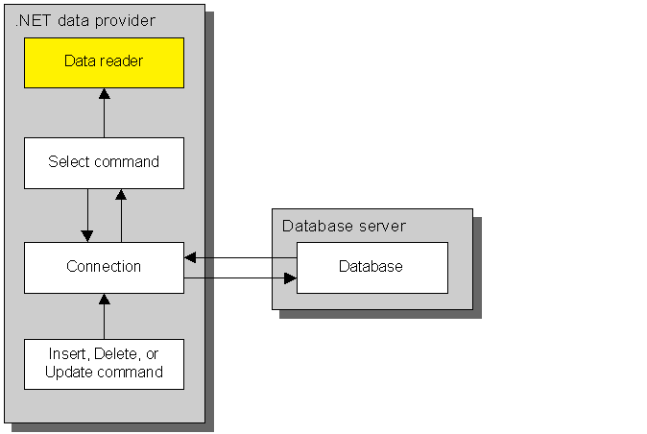
3. Data Reader

Slide 17
How to create a SqlDataReader object
sqlCommand.ExecuteReader([behavior])
Common CommandBehavior enumeration members
Member | Description
CloseConnection | Closes the connection when the data reader is closed.
Default | Equivalent to specifying no command behavior
SingleResult | Only a single result set is returned
SingleRow | Only a single row is returned
Notes:
SqlDataReader
When you execute a command object that contains a Select statement, the command object returns the result set in a dataReader object.
To work with that result set, you use properties and methods of the data reader object. You'll learn how to do that in the topics that follow.
The slide presents the basic skills for creating and working with a data reader.
To create a data reader, you use the ExecuteReader method of a command object that contains a Select statement.
Notice that when you execute this method, you can specify a behavior. The behavior you specify must be a member of the CommandBehavior enumeration. Some of the most common members of this enumeration are listed in this slide. You can use these members to simplify your code or to improve the efficiency of your application.
The CloseConnection behavior will close the associated Connection object when the command is executed and when the associated DataReader object is closed.

Slide 18
Common members of the SqlDataReader class
Indexer
[columnname] | Gets the value of the column with the specified name.
[index] | Gets the value of the column at the specified position
Property
IsClosed | Gets a value that indicates if the data reader is closed
Method
Close() | Closes the data reader; sets any output parameters and return value if a stored procedure is executed
Read() | Advances the data reader to the next row of data in de current result set
NextResult() | Advances the data reader to the next result set and returns a Boolean value that indicates whether there are additional
Notes:
SqlDataReader
After you create a dataReader, you can use the properties and methods shown in this slide to work with it.
To retrieve the next row of data in the result set, for example, you use the Read method.
Note that you must execute the Read method to retrieve the first row of data. It's not retrieved automatically when the data reader is created.
To access a column in the most recently retrieved row, you use the Item property.
Like many of the other objects you've seen previously, the Item property is the default property of a data reader. Because of that, you can omit it.

Slide 19
Code that uses a data reader to populate a list with State objects
connection.Open();
SqlDataReader reader =
selectCommand.ExecuteReader(
CommandBehavior.CloseConnection);
List<State> stateList = new List<State>();
while (reader.Read()){
State state = new State();
state.StateCode = reader["StateCode"].ToString();
state.StateName = reader["StateName"].ToString();
stateList.Add(state);
}
reader.Close();
Notes:
SqlDataReader
The code example in this slide illustrates how you use a data reader.
First, the connection that's used by the SqlCommand object is opened.
Although it's not shown here, this command contains a Select statement that retrieves columns from the States table.
Then, the ExecuteReader method of the command is used to retrieve the data and create a data reader that can process the state rows. Because the CloseConnection behavior is included on this method, the connection will be closed automatically when the data reader is closed.
The ExecuteReader method also opens the data reader and positions it before the first row in the result set.
Next, a List<> object that can hold State objects is created and a Do While statement is used to loop through the rows in the result set.
The condition on this statement executes the Read method of the data reader. This works because the Read method returns a Boolean value that indicates whether the result set contains additional rows.
As long as this condition is true, the application processes the row that was retrieved.
In this case, the application creates a State object for each row and adds it to the List<> object.
After all of the rows have been processed, the data reader is closed.
Although most commands execute a single Select statement and return a single result set, a command can also execute two or more Select statements and return two or more result sets. That way, only one trip is made to the server for all the statements.
To combine two or more Select statements, you code a semicolon between them.
For example, suppose you want to retrieve vendor, terms, and account information. To do that, you could code three Select statements in a single command like this:
SELECT * From Vendors;
SELECT TermslD, Description FROM Terms;
SELECT AccountNo, Description FROM GLAccounts
To process the three result sets returned by these statements, you would read the vendor rows in the first result set. Then, you would use the NextResult method to move to the result set that contains the terms, and you would read the rows in that result set. Finally, you would repeat this process for the rows in the third result set.

Slide 20
Common methods for improving the efficiency of column lookups
state.StateCode = reader[0].ToString();
➔ Error prone
position = GetOrdinal(name)
GetBoolean(position)
GetDateTime(position)
GetDecimal(position)
GetInt16(position)
GetInt32(position)
GetInt64(position)
GetString(position)
Notes:
SqlDataReader
When you retrieve a column from a data reader using the column name as shown in the previous slide, the data reader has to search for the appropriate column.
To make the retrieval operation more efficient, you can specify the position of the column instead of its name.
One way to do that is to use a literal value.
For example, you can use a statement like this to retrieve the value of the first column in the States data reader:
state.StateCode = reader[0].ToString();
This technique is error prone, though, because you can easily specify the wrong position for a column. In addition, if the columns that are retrieved change, you may have to modify your code to accommodate the new column positions.
An alternative is to use the GetOrdinal method of the data reader to get the position, or ordinal, of a column with the specified name. Then, you can assign the result of that method to a variable and use the variable to refer to the column. To understand how this works, take a look at the code example on the next slide.

Slide 21
Code that uses type-specific Get methods and ordinals
string selectStatement =
"SELECT InvoiceNumber, InvoiceDate, InvoiceTotal " +
"FROM Invoices " +
"WHERE InvoiceTotal - PaymentTotal - CreditTotal > 0 ";
SqlCommand selectCommand =
new SqlCommand(selectStatement, connection);
connection.Open();
SqlDataReader reader = selectCommand.ExecuteReader();
int invoiceNumberOrdinal = reader.GetOrdinal("InvoiceNumber");
int invoiceDateOrdinal = reader.GetOrdinal("InvoiceDate");
int invoiceTotalOrdinal = reader.GetOrdinal("InvoiceTotal");
while (reader.Read())
{
Invoice invoice = new Invoice();
invoice.InvoiceNumber = reader.GetString(invoiceNumberOrdinal);
invoice.InvoiceDate = reader.GetDateTime(invoiceDateOrdinal);
invoice.InvoiceTotal = reader.GetDecimal(invoiceTotalOrdinal);
invoiceList.Add(invoice);
}
reader.Close();
connection.Close();
Notes:
SqlDataReader
The command contains a Select statement that will return a result set with three columns.
After the connection is opened and the ExecuteReader method is executed, the GetOrdinal method is used to get the position of each of the columns.
Notice that this method must locate the column using its name just as the code in the previous slide did.
In this case, though, the column is looked up by name only once.
Then, within the loop that processes the rows in the result set, the columns are accessed by their ordinals.
When you refer to a column using its ordinal, you can also use the other methods listed on the slide.
These methods let you specify the type of data that's retrieved. The three columns in the code on the slide, for example, are retrieved using the GetString, GetDateTime, and GetDecimal methods. This can improve the efficiency of the operation by eliminating unnecessary data conversion.

Slide 22
Demo:
An Invoices by Due Date application that uses a data reader
(Source Code: wpfDisplayInvoicesDueDemo : BlackBoard)
Notes:
Demo
To illustrate how you can use a data reader to work with the data returned by a Select statement, we’ll take a look at an application that lists invoices by due date.
Although this is a simple application, you'll see that it consists of three classes in addition to the form class. That will help you understand how you can separate the business and database processing from the processing for the user interface.

Slide 23
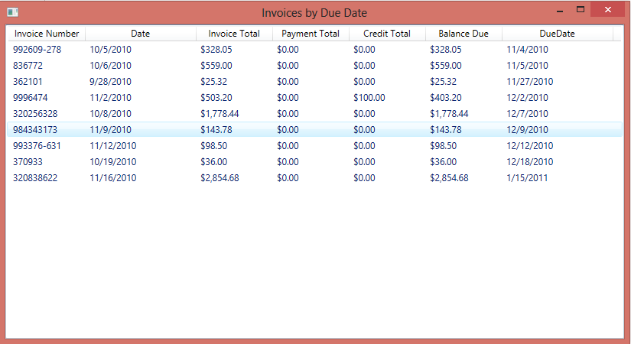
Notes:
Demo
This slide presents the design of the Invoices by Due Date form. As you can see, this form includes information for each invoice with a balance due.
This information is displayed in a ListView control, which can be used to display a collection of items. This control is a common control that's available from the Toolbox.
To display the invoices, we set the View property of the ListView control to a GridView, which displays the data in a row and column format.
In the GridView we specify the colums (GridViewColumn) that will be displayed. For each column we specify the Header, the Width and the binding (DisplayMemberBinding).
If you aren't familiar with the ListView control, you may want to consult the Visual Studio documentation on this control to learn more about how it works:
https://docs.microsoft.com/dotnet/framework/wpf/controls/listview-overview
https://docs.microsoft.com/dotnet/framework/wpf/controls/gridview-overview

Slide 24
Properties and methods of the Invoice class
Property | Description
InvoiceNumber | The invoice number assigned by the vendor
InvoiceDate | The date the invoice was issued
InvoiceTotal | The total amount of the invoice
PaymentTotal | The total payments that have been applied to the invoice
CreditTotal | The total credits that have been applied to the invoice
DueDate | The date the invoice is due
BalanceDue | The unpaid balance of the invoice.
Notes:
Demo
The slide summarizes the classes used by this application.
The application has a three-layer architecture that consists of presentation, business, and database classes.
For this application, the business and database classes are stored in a class library named PayablesData. That way, they can be used by other applications that require the data or operations they provide.
The Invoice class is a business class that represents a single invoice.
It has six public properties that represent the data from the Invoices table that's used by this application and a method that calculates and returns the unpaid balance of an invoice.
This class starts by defining the private fields for the class.
When an object is created from this class, these fields can be used to store the values of the properties defined by the class.
This class also contains a single parameterless constructor.
Because this constructor doesn't contain any statements, all of the fields defined by the class will be assigned default values when the class is instantiated.
Next, this class contains six properties that can be used to get or set the values of the private fields. Note that properties and fields are defined only for the data that's used by the Invoices by Due Date application.
We did that just to keep this code as simple as possible. In a production application, however, this class would define properties for all of the columns in the Invoices table. That way, any application that accessed this table could use this class.
The Invoice class also contains one readonly property.
This method calculates the balance due for an invoice using the invoice total, payment total, and credit total fields and then returns the value to the calling method. If you look back at the previous slide, you'll see that this is the value that's displayed in the next to last column of the ListView control.

Slide 25
Method of the InvoiceRepository class
Method | Description
GetInvoicesDue() | Returns a IList<Invoice> object that contains all of the invoices in the Invoices table with unpaid balances.
Method of the ConnectionFactory class
Method | Description
CreateSqlConnection() | Returns a SqlConnection object for the Payables database.
Notes:
Demo
The InvoiceRepository and ConnectionFactory classes are database classes that contain one method each that works directly with the database.
The GetlnvoicesDue method in the InvoiceRepository class returns a List<> object that holds one Invoice object for each invoice in the Invoices table with a balance due. The CreateSqlConnection method in the ConnectionFactory class returns a connection to the Payables database.
The InvoiceRepository class consists of a single method named GetlnvoicesDue that returns a list of Invoice objects.
This method starts by creating a new List<> object that can hold Invoice objects.
Then, it creates a connection by calling the CreateSqlConnection method of the ConnectionFactory class. Next, this method defines the Select statement that will be used to retrieve invoices from the Invoices table. Notice that this statement only retrieves invoices with a balance due (InvoiceTotal - PaymentTotal - CreditTotal > 0).
In addition, it sorts the invoices by due date.
After it creates the connection and defines the Select statement, this method creates a command object that uses that Select statement and connection.
Then, it opens the connection and uses the ExecuteReader method to execute the command.
Next, it uses the data reader that's created by the ExecuteReader method to get each invoice that's returned by the Select statement.
For each invoice, it creates a new Invoice object and adds it to the invoice list.
Then, after all the invoices have been processed, it closes the data reader and the connection and then returns the list of Invoice objects to the calling method.
Notice that the statements that open the connection and data reader and process the rows in the data reader are coded within the try block of a try-catch statement.
Then, if a SqlException occurs, the catch block throws the exception to the calling method. Because of that, the method that calls this method should catch this exception. Whether or not an exception occurs, the statement that closes the connection is coded within the finally block. That way, if the statement that opens the connection is successful but the statement that executes the command isn't, the connection is still closed.
The ConnectionFactory class contains a single method named CreateSqlConnection that returns a connection to the Payables database. The InvoiceRepository class calls this method to get the connection that's used by the command it executes. Note that the connection string is hard coded into this method. As explained earlier, however, the connection string for a production application is typically stored in an external configuration file.
Then, the CreateSqlConnection method would read the connection string from this file. That way, you could change the location of the database without recompiling the application.
At this point, you may be wondering why I coded the CreateSqlConnection method in a separate class rather than in the InvoiceRepository class. The reason is that this method isn't specific to the Invoices table. Because of that, it can be used to get a connection for any method in any database class in the class library. Although this class library only contains one other database class, a complete class library would probably contain a database class for each table in the database.

Slide 26
Notes:
Demo
The UI: To start, create a WPF window. A using statement imports the PayablesData namespace, which is the namespace for the class library that contains the Invoice, InvoiceRepository, and ConnectionFactory classes. For this to work, a reference to the class library must be added to the project that contains the Invoices by Due Date form. To do that, you can use the Project+Add Reference command, and then select the PayablesData project from the Projects tab of the Add Reference dialog box. The code within the window class provides for populating the ListView control when the form is loaded. To start, it declares a variable that will contain a list of Invoice objects and then assigns the list that's returned by the GetlnvoicesDue method of the InvoiceRepository class to that list. Because the GetInvoicesDue method can throw a SqlException, this method is coded within the try block of a try-catch statement. Then, if an exception occurs, the catch block displays an error message and closes the window.
After the invoices are loaded into the invoice list, this code checks to see if the list contains at least one item. If so, it loads the items into the ListView control. Otherwise, it displays a message indicating that all the invoices are paid in full and it closes the form.
To load the invoices into the ListView control, this code uses a for statement that loops through the invoices in the invoice list. For each invoice, it adds the InvoiceNumber property to the list of items in the control. That causes the invoice number to be displayed in the first column of the control. Then, the other properties of each invoice are added as subitems. That causes these values to be displayed in columns following the invoice number.
If you aren't familiar with the ListView control, you may want to consult the Visual Studio documentation on this control to learn more about how it works. In general, though, when its View property is set to Details, it works like any collection of rows that contain columns.

Slide 27
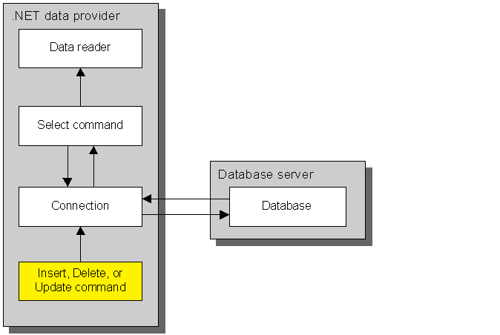
2. Command (INSERT/UPDATE/DELETE)
Notes:
Command (Insert/update/delete)
In addition to executing queries that return result sets, you can use a command to execute queries that return a single value or that perform an action against the database. You'll learn how to work with commands that execute these two types of queries in the last two topics of this chapter.

Slide 28
Notes:
Command (Insert/update/delete)
The code example in the slide shows you how to execute a command that returns a single value, called a scalar value.
To do that, you execute the ExecuteScalar method of the command.
In this case, the command contains a Select statement that retrieves the total balance due for all the invoices in the Invoices table.
This type of summary value is often called an aggregate value. A scalar value can also be the value of a single column, a calculated value, or any other value that can be retrieved from the database.
In the Vendor Maintenance application that's presented in the next chapter, for example, you'll see how the ExecuteScalar method is used to retrieve the value of an identity column that's generated for a row that's added to a database.
Since the ExecuteScalar method returns an Object type, you must cast that object to an appropriate data type to get its value.
In this example, the object is cast to a decimal value.
To avoid any confusion, it is possible to use the ExecuteScalar method with a Select statement that retrieves more than one value. In that case, though, the ExecuteScalar method returns only the first value and the others are discarded.

Slide 29
Notes:
Command (Insert/update/delete)
As you know, you can use an Insert, Update, or Delete statement to perform actions against a database.
For that reason, these statements are often referred to as action queries.
To execute an action query, you use the ExecuteNonQuery method of a command as shown in the code example on the slide.
This example executes a command that contains a Delete statement that will delete all of the invoices in the Invoices table that have a balance due of zero.
Notice that the ExecuteNonQuery method returns an integer that indicates the number of rows in the database that were affected by the operation.
In this case, the value is used to display a message to the user. In other cases, you can use it to check if the operation was successful.

